Slide 1
Python Programming I

Slide 2
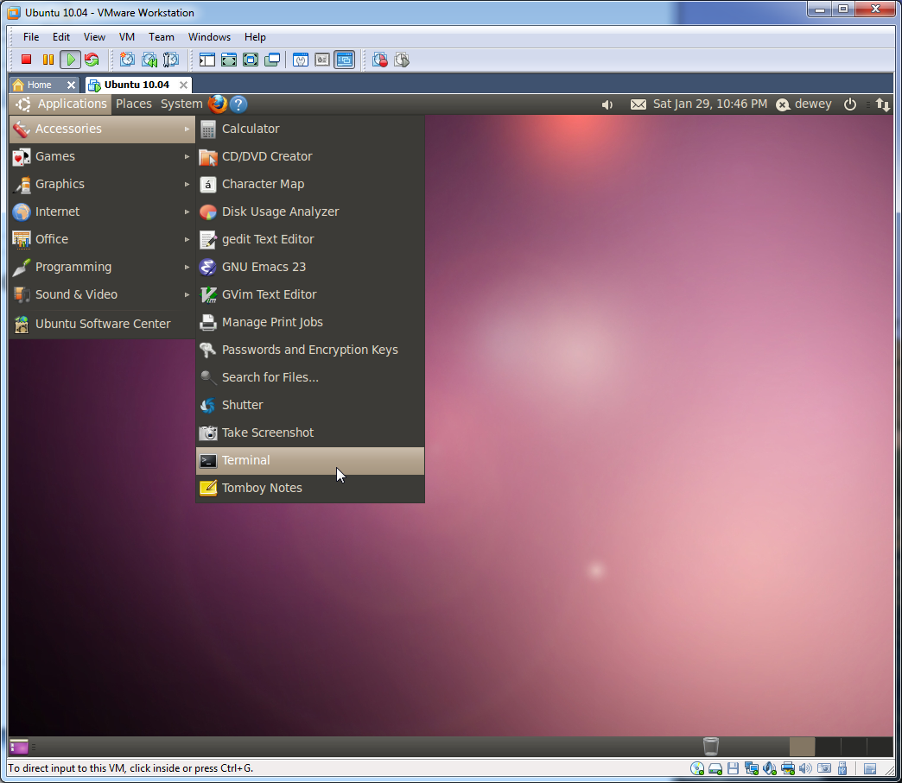
Python Interpreter
Mess around with Python in “real-time!”
Applications > Accessories > Terminal
Or type Ctrl-Alt-T
Type python3 in the terminal to reach the interpreter

Slide 3
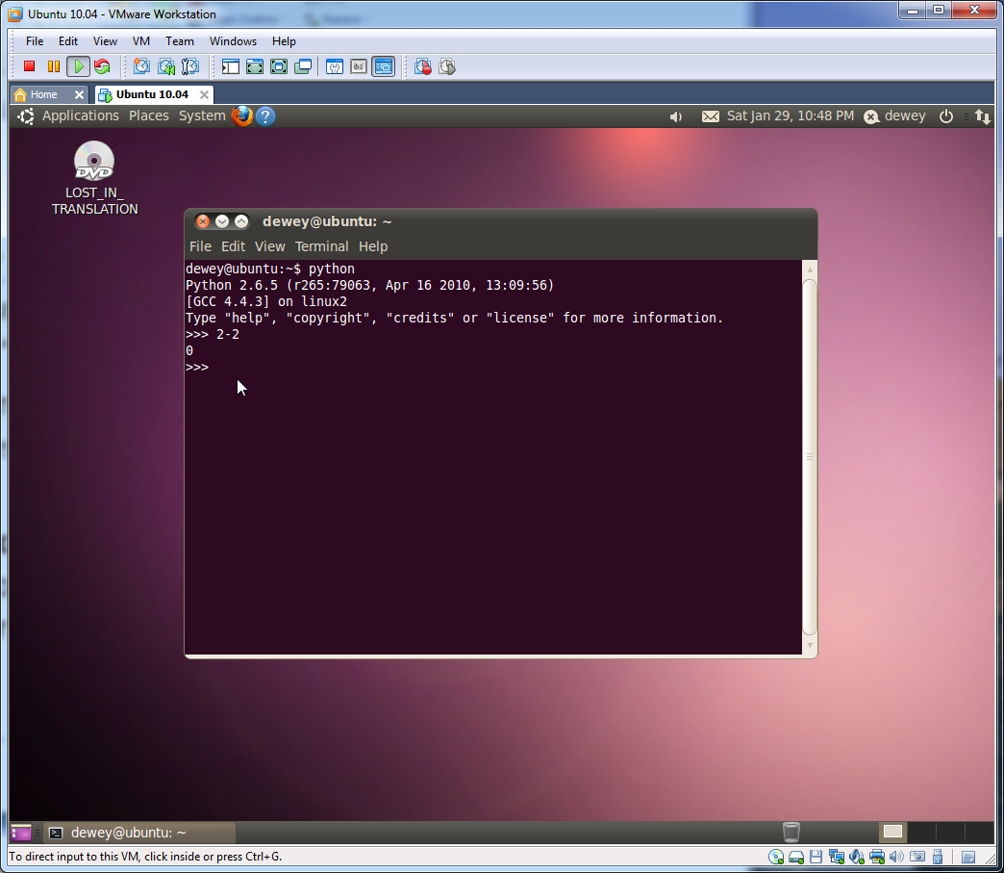
Python Interpreter
Mess around with Python in “real-time!”
Applications > Accessories > Terminal
Or type Ctrl-Alt-T
Type python3 in the terminal to reach the interpreter

Slide 4
The Python Programming Language
Strongly typed (can’t mix datatypes)
Implicitly typed (no need to declare variables)
Case sensitive (spam and SPAM are different)
Object oriented (everything’s an object)

Slide 5
Getting help
Use help() to get info on anything and everything
Use dir() to find all of an object’s methods (will explain later)
Use __doc__ method to get quick documentation
>>> import math
>>> help(math.sqrt)
Help on built-in function sqrt in module math:
sqrt(...)
sqrt(x)
Return the square root of x.
>>> dir(math)
['__doc__', '__name__', '__package__', 'acos', 'acosh', 'asin', 'asinh', 'atan', 'atan2', 'atanh', 'ceil', 'copysign', 'cos', 'cosh', 'degrees', 'e', 'erf', 'erfc', 'exp', 'expm1', 'fabs', 'factorial', 'floor', 'fmod', 'frexp', 'fsum', 'gamma', 'hypot', 'isinf', 'isnan', 'ldexp', 'lgamma', 'log', 'log10', 'log1p', 'modf', 'pi', 'pow', 'radians', 'sin', 'sinh', 'sqrt', 'tan', 'tanh', 'trunc']
>>> print(math.log.__doc__)
log(x[, base])
Return the logarithm of x to the given base.
If the base not specified, returns the natural logarithm (base e) of x.

Slide 6
Python syntax
Programming “blocks” must be indented
Indented blocks are preceded by a colon
Comments start with #
Assign values with =
Test equality with ==
>>> def counter(top):
print("Beginning counter”)
for i in range(top):
print(i)
>>> counter(5)
Beginning counter
0
1
2
3
4
>>> a = 3
>>> b = 5
>>> a + b
8
>>> a == b
False

Slide 7
Operators, type conversion
Arithmetic operators: +, -, *, /, **, %
>>> 1+2+3
6
>>> a = 2
>>> b = 5
>>> a*b
10
>>> b**a
25
>>> c = "3"
>>> a+c
Traceback (most recent call last):
File "<stdin>", line 1, in <module>
TypeError: unsupported operand type(s) for +: 'int' and 'str’
>>> a+int(c)
5
>>> c = int(c)
>>> a+c
5
>>> 5%2
1
>>> 5/2
2.5
>>> 5+3/5
5.6
>>> a = 2
>>> b = 5
>>> b/a
2.5
>>> b//a
2
>>>b//-a
-3
%: mod
**: power
#integer division
Int()

Slide 8
Data types: Lists
One-dimensional arrays
Anything can be put inside lists (including other lists)
List indices start from 0
Lists can be sliced and concatenated
Last elements can be accessed using negative-indexing
Individual elements can be changed (mutable)
>>> a = ['spam', 'eggs', 100, 1234]
>>> a
['spam', 'eggs', 100, 1234]
>>> a[3]
1234
>>> a[:2] + ['bacon', 2*2]
['spam', 'eggs', 'bacon', 4]
>>> a[2] = a[2] + 23
>>> a
['spam', 'eggs', 123, 1234]
>>> q = [2, 3]
>>> p = [1, q, 4]
>>> p
[1, [2,3], 4]
>>> p[-1]
4
>>> p.append('BANANA')
>>> print(p)
[1, [2, 3], 4, 'BANANA']
>>>

Slide 9
Data types: Lists
One-dimensional arrays
Anything can be put inside lists (including other lists)
List indices start from 0
Lists can be sliced and concatenated
Last elements can be accessed using negative-indexing
Individual elements can be changed (mutable)
>>> a = range(10)
>>> print(a)
[0, 1, 2, 3, 4, 5, 6, 7, 8, 9]
>>> len(a)
10
>>> a[:] #shallow copy of list a
[0, 1, 2, 3, 4, 5, 6, 7, 8, 9]
>>> a[2:7]
[2, 3, 4, 5, 6]
>>> a[:7]
[0, 1, 2, 3, 4, 5, 6]
>>> a[:3]
[0, 1, 2]
>>> a[2:8:2]
[2, 4, 6]
>>> a[::2]
[0, 2, 4, 6, 8]

Slide 10
More on the range function
range(stop) OR range(start, stop[, step])
Versatile function to create lists containing arithmetic progressions. It is most often used in for loops.
The arguments must be plain integers.
If step argument omitted, it defaults to 1. If start argument omitted, it defaults to 0.
The full form returns a list of plain integers [start, start + step, start + 2 * step, ...].
If step is positive, the last element is the largest start + i * step less than stop.
If step is negative, the last element is the smallest start + i * step greater than stop.
Step must not be zero (or else ValueError is raised).
Examples:
>>> range(10)
[0, 1, 2, 3, 4, 5, 6, 7, 8, 9]
>>> range(1, 11)
[1, 2, 3, 4, 5, 6, 7, 8, 9, 10]
>>> range(0, 30, 5)
[0, 5, 10, 15, 20, 25]
>>> range(0, 10, 3)
[0, 3, 6, 9]
>>> range(-10, 0, 1)
[-10, -9, -8, -7, -6, -5, -4, -3, -2, -1]
>>> range(0, -10, -1)
[0, -1, -2, -3, -4, -5, -6, -7, -8, -9]
>>> range(0)
[]
>>> range(1, 0)
[]

Slide 11
Lists Methods (try these on your own)
append(item) Append an item to the end of the list:
>>> l = [1,2,3]
>>>l.append(4)
>> l
[1,2,3,4]
count(item) Count the number of occurrences of the given item in the list. Note: This function also works on tuples (see next slides).
>>> l = [1,2,3,1,2,1]
>>> l.count(1)
3
l.count(10)
0
extend(other_list) Extend one list with the contents of other_list.
>>> l = [1,2]
>>> l.extend([3,4])
>>> l
[1,2,3,4]

Slide 12
Lists Methods (cont.)
index(val) Returns the index of the first item in the list whose value matches the given value. ValueError if no match is found. Note: This function also works on tuples.
>>> l = [1,2,2,1,3]
>>> l.index(2)
1
>>> l.index(10)
ValueError: list.index(x): x not in list
insert(pos, item) Insert the given item at the specified position. If the position is past the end of the list, insert at the end.
>>> l = [1,2,3,4]
>>> l.insert(1,10)
>>> l
[1,10,2,3,4]
>>> l.insert(10,"end")
>>> l
[1,10,2,3,4,"end"]

Slide 13
Lists Methods (cont.)
pop([pos]) Remove and return the element at the specified position. If no position is given, defaults to the last element in the list.
>>> l = [1,2,3,4,5]
>>> l.pop()
5
>>> l
[1,2,3,4]
>>> l.pop(0)
1
remove(val) Remove the first element in the list whose value matches the given value. ValueError if no match is found.
>>> l = [1,2,3,2,1]
>>> l.remove(2)
>> l
[1,3,2,1]
>>> l.remove(10)
ValueError: list.remove(x): x not in list

Slide 14
Lists Methods (cont.)
reverse() Reverse the order of elements within the list. Changes the list in place instead of returning a modified copy.
>>> l = [1,2,3,4,5]
>>> l.reverse()
>>> l
[5,4,3,2,1]
sort() Sorts the list in place ordering elements from smallest to largest.
>>> l = [10,2,3,10,100,54]
>>> l.sort()
>>> l
[2, 3, 10, 10, 54, 100]
See also sorted(list):
>>> sorted([5, 2, 3, 1, 4])
[1, 2, 3, 4, 5]
>>> sorted([5, 2, 3, 1, 4],reverse=True)
[5,4,3,2,1]

Slide 15
Tuples – ()
A tuple, enclosed by parentheses (), is an immutable list
Elements cannot be changed
You can’t add elements to it or remove them from it
Tuples are faster than lists
Tuples are secure (write protected)
Tuples can be used as keys in a dictionary - lists cannot
>>> x = (1,2,3)
>>> x[0]
1
>>> x[0] = 5
Traceback (most recent call last):
File "<stdin>", line 1, in <module>
TypeError: 'tuple' object does not support item assignment

Slide 16
Tuples – ()
>>> t = 12345, 54321, 'hello!'
>>> t[0]
12345
>>> t
(12345, 54321, 'hello!')
>>> # Tuples may be nested:
... u = t, (1, 2, 3, 4, 5)
>>> u
((12345, 54321, 'hello!'), (1, 2, 3, 4, 5))
>>> x, y, z = t # x, y, z = 12345, 54321, 'hello!'

Slide 17
Data Types: Strings
Any text enclosed in single quotes(‘ ‘) or double quotes(“ “)
Backslash(\) is used as the escaping character.
\n: newline, \t: tab
Strings can be concatenated with +, and repeated with *
Strings can be indexed (index of the first character of a string is 0)
Substrings are specified with the slice notation: two indices separated by a colon
>>> word = 'Help' + 'A'
>>> word*3
'HelpAHelpAHelpA'
>>> word[3]
'p'
>>> word[2:4] #slicing
'lp'
>>> word[:2] # The first two characters
'He'
>>> word[2:] # Everything except the first two characters
'lpA'

Slide 18
String concatenation, slices, indexing
“print” can print built-in objects to standard out
>>> x = '01234'
>>> y = "56789"
>>> x+y
'0123456789'
>>> x = x+y
>>> x
'0123456789'
>>> x[0]
'0’
>>> x[9]
'9’
>>> x[2:8]
'234567’
>>> x[:2]
'01’
>>> x[8:]
'89’
>>> x[-2:]
'89’
String addition

Slide 19
String and “print”
“print” can print built-in objects to standard out
>>> x[2:10]
'23456789'
>>> x[10]
Traceback (most recent call last):
File "<stdin>", line 1, in <module>
IndexError: string index out of range
>>> x = 3.1415926535
>>> print(x)
3.1415926535
>>> print("pi is“, x)
pi is 3.1415926535
>>> print("pi is\n”, x)
pi is
3.1415926535

Slide 20
Some String Methods (try these on your own)
# Try these useful string methods:
>>> "Python”.index(”thon")
>>> "Python”.index(”py")
>>> '_'.join(['a','b','c'])
>>> print("\t".join(["John","Smith"]))
>>> "PyThon".lower()
>>> ' spacious '.lstrip()
>>> " spacious ".strip().rstrip("sucio")
>>> "carnivore".replace("carni","herbi")
>>> "herbivore".startswith("herb")
https://docs.python.org/3/library/stdtypes.html#string-methods

Slide 21
Dictionaries – {}
Use dictionaries when storing a value with some key and extracting the value given the key (e.g. address book – key=names values=addresses)
Keys should be unique!
A pair of braces creates an empty dictionary: {}
You can initialize an dictionary with initial key:value pairs
You can add or modify a key:value pair
You can delete a key:value pair using del
dictionaries are indexed by keys, which can be any immutable type
strings or numbers can always be keys
Tuples can be used as keys if they contain only immutable type
Useful methods for dictionaries: d.keys(), d.values()
>>> tel = {'jack': 4098, 'sape': 4139}
>>> tel['guido'] = 4127 #add new key:value pair
>>> tel
{'sape': 4139, 'jack': 4098, 'guido': 4127}
>>> tel['jack'] #extract the value with the key ‘jack’
4098

Slide 22
Dictionaries – {}
Use dictionaries when storing a value with some key and extracting the value given the key
Keys should be unique!
A pair of braces creates an empty dictionary: {}
You can initialize an dictionary with initial key:value pairs
You can add or modify a key:value pair
You can delete a key:value pair using del
dictionaries are indexed by keys, which can be any immutable type
strings or numbers can always be keys
Tuples can be used as keys if they contain only immutable type
Useful methods for dictionaries: d.keys(), d.vals()
>>> del tel['sape'] #delete the key:value pair with the key ‘sape’
>>> tel
{'jack': 4098, 'guido': 4127}
>>> tel.keys() #retrieve the list of keys in the dictionary
['jack', 'guido']
>>> 'guido' in tel #test whether ‘guido’ key is in the dictionary
True

Slide 23
Five ways to initialize a dictionary
The following examples all return a dictionary equal to
{"one": 1, "two": 2, "three": 3}:
>>> a = dict(one=1, two=2, three=3)
>>> b = {'one': 1, 'two': 2, 'three': 3}
>>> c = dict(zip(['one', 'two', 'three'], [1, 2, 3]))
>>> d = dict([('two', 2), ('one', 1), ('three', 3)])
>>> e = dict({'three': 3, 'one': 1, 'two': 2})
>>> a == b == c == d == e
True

Slide 24
Dictionary Methods (try these on your own)
len(d) Return the number of items in the dictionary d.
del d[key] Remove d[key] from d. Raises a KeyError if key is not in the map.
key in d Return True if d has a key key, else False.
key not in d Equivalent to not key in d.
clear() Remove all items from the dictionary.
fromkeys(seq[, value]) Create a new dictionary with keys from seq and values set to value.
items() Return a copy of the dictionary’s list of (key, value) pairs.
CPython implementation detail: Keys and values are listed in an arbitrary order which is non-random, varies across Python implementations, and depends on the dictionary’s history of insertions and deletions
update([other]) Update the dictionary with the key/value pairs from other, overwriting existing keys. Return None.

Slide 25
Dictionaries of Lists and Lists of Dictionaries …
>>> d = {1: ['1'], 2: ['1', '2'], 3: ['1','2','3']}
>>> d.items()
>>> l = [{0:'0'}, d]
>>> len(l)
>>> l[1]
>>> dd = {1:{"one":'1'}, 2:{"two":'2'}, 3:{"three":'3'}}
>>> len(dd)
>>> dd[2]

Slide 26
Writing Scripts
Create a file with a .py extension
Write code and save
Open a terminal. At the command line, type:
python filename.py
Note: Making the script executable,
Add the following on the first line:
#!/usr/bin/env python
Change the script mode:
chmod u+x filename.py
Run the script:
./filename.py

Slide 27
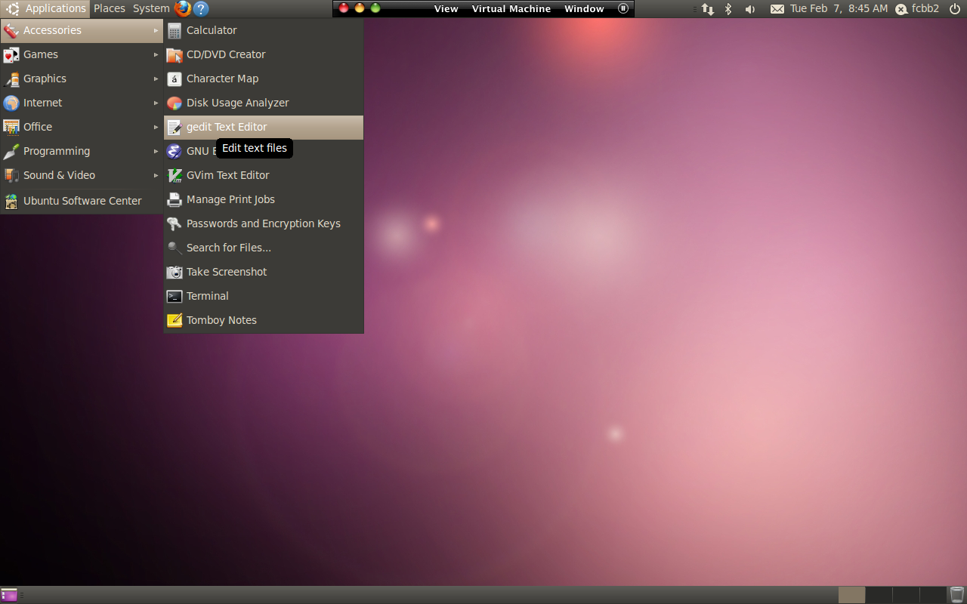
Editor (Python Scripts)
Applications > Accessories > gedit text editor (or use any text editor you prefer)

Slide 28
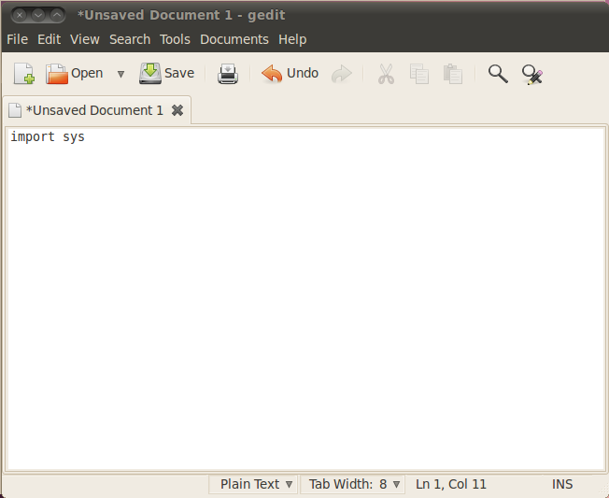

Slide 29
Scripts
Create a file with a .py extension
Write code and save
Open a terminal. At the command line, type:
python filename.py
Note: Making the script executable,
Add the following on the first line:
#!/usr/bin/env python
Change the script mode:
chmod u+x filename.py
Run the script:
./filename.py

Slide 30
Two sample scripts using list or dict
 | A | C | G | T
A | 0.1 | 0.2 | 0.3 | 0.4
C | 0.4 | 0.3 | 0.2 | 0.1
G | 0.2 | 0.2 | 0.3 | 0.3
T | 0.3 | 0.3 | 0.2 | 0.2
M=
M_{ij}=P(nucleotide_{i} precedes nucleotide_{j})
model-1.py
dna2int = {'A':0,'C':1,'G':2,'T':3}
model = [[0.1,0.2,0.3,0.4],\
[0.4,0.3,0.2,0.1],\
[0.2,0.2,0.3,0.3],\
[0.3,0.3,0.2,0.2]]
# what is the probability of seeing 'A' followed by 'C'?
print(model[dna2int['A']][dna2int['C']])

Slide 31
Cont.
 | A | C | G | T
A | 0.1 | 0.2 | 0.3 | 0.4
C | 0.4 | 0.3 | 0.2 | 0.1
G | 0.2 | 0.2 | 0.3 | 0.3
T | 0.3 | 0.3 | 0.2 | 0.2
model-2.py
model = {'AA': 0.1, 'AC': 0.2, 'AG': 0.3, 'AT': 0.4,\
'CA': 0.4, 'CC': 0.3, 'CG': 0.2, 'CT': 0.1,\
'GA': 0.2, 'GC': 0.2, 'GG': 0.3, 'GT': 0.3,\
'TA': 0.3, 'TC': 0.3, 'TG': 0.2, 'TT': 0.2}
# what is the probability of seeing 'A' followed by 'C'?
print(model['AC'])

Slide 32
The if Statement - if (cond): (body)
a = int(raw_input("input \
number: "))
if a < 0:
print("negative”)
elif a == 0:
print("zero”)
else:
print("positive“)
For conditional execution
run body statements (body) only when the condition (cond) is true
(cond) The standard comparison operators can be used:
== (equal to)
!= (not equal to)
< (less than)
> (greater than)
<= (less than or equal to)
>= (greater than or equal to)

Slide 33
(cond)
Any non-zero integer value is true; zero is false. Any sequence with a non-zero length is true; empty sequences are false
if-else-1.py
if-else-2.py
if -1 :
print("-1 means True”)
else:
print("-1 means False”)
if 0:
print("0 means true”)
else:
print("0 means false”)
If [0] :
print(”[0] means True”)
else:
print(”[0] means False”)
If []:
print(“[] means true”)
else:
print(“[] means false”)
-1 means True
0 means false
[0] means True
[] means false

Slide 34
The for Statement – for (obj) in (seq): (body)
Used to iterate over the elements (obj) of a sequence (seq)
The (body) should be indented
Example (for.py)
nts = ['A', 'C', 'G', 'T']
for i in range(len(nts)):
print(i, nts[i])
Output:
0 A
1 C
2 G
3 T

Slide 35
The while Statement - while (cond): (body)
Used for repeat execution
Executes (body) as long as the (cond) remains true
Conditions are the same as the if statement
The (body) should be indented
Example
a = 0
b = 1
while b < 10:
print(b)
a, b = b, a+b

Slide 36
break
The break statement “breaks” out of the smallest enclosing loop
break.py
for i in range(2,4): #what are the values of i?
series = []
x = 0
while 1:
series.append(i*10+x)
x += 1
if x == 10:
break
print(",".join([str(num) for num in series]))
Output:
20,21,22,23,24,25,26,27,28,29
30,31,32,33,34,35,36,37,38,39

Slide 37
continue
The continue statement continues with the next iteration of the loop; steps within smallest loop that are after continue are skipped.
continue.py
scores = ['1.2','1.5','NA','6.8','5.0']
total = 0
for value in scores:
if value == 'NA':
continue
total += float(value)
print(total)
Output:
14.5

Slide 38
Defining Functions : def Statement
The keyword def introduces a function definition
It must be followed by the function name and the parenthesized list of formal parameters.
The statements that form the body of the function start at the next line, and must be indented
All functions must be defined prior to being used
Example (fib1.py)
def fib1(n):
# return Fibonacci number Fn
if n == 0:
return 0
else:
a = 0
b = 1
ans = b # F1
for c in range(1,n):
ans = a + b
a = b
b = ans
return ans

Slide 39

Cont.
fib2.py
import math
def fib2(n):
return 1/math.sqrt(5)*(((1+math.sqrt(5))/2)**n-\
((1-math.sqrt(5))/2)**n)
x = fib2(5) # x is 5.0

Slide 40
Cont.
fib3.py
def fib3(n):
# return Fibonacci number Fn
if n == 0:
return 0
elif n == 1:
return 1
else:
return (fib3(n-1)+fib3(n-2))
However, fib3.py takes about 1 sec to get F30 (much slower than fib1 and fib2)
We might talk about programming efficiency next time.
http://stackoverflow.com/questions/3021/what-is-recursion-and-when-should-i-use-it

Slide 41
File I/O
filehandle = open(“/path/filename.txt”,’r’)
text = filehandle.readlines()
text will be a list of strings
Each line will be one string element of the list
filehandle.close()
Use file or open command
‘r’ - read
‘w’ - write
‘a’ - append
Note: filehandle.readline() will read one line at a time

Slide 42
mutation.txt
chr strand pos ref mut score
chr3 + 526452 A C 0.52
chrX + 55267 T C 0.21
chr1 - 256288 C G 0.77
chr21 + 526345 C A 0.24
chr12 + 98224 G T 0.37
chr5 + 425552 G A 0.55
parseMutation.py
scoreDict = {}
fd = open("mutation.txt","r")
line = fd.readline() #skip header
line = fd.readline() #first mutation
while line != "":
cols = line.rstrip().split("\t")
mutationKey = "_".join(cols[:5])
#mutationKey = tuple(cols[:5])
scoreDict[mutationKey] = float(cols[-1])
line = fd.readline()
fd.close()
for key in scoreDict.keys():
print(key, scoreDict[key])
chr3\t+\t526452\tA\tC\t0.52\n
Throw away ‘\n’ and split by ‘\t’
[‘chr3’,’+’,’526452’,’A’,’C’,’0.52’]
chr3_+_526452_A_C
('chr21', '+', '526345', 'C', 'A')
chrX\t+\t55267\tT\tC\t0.21\n

Slide 43
Output (using string as key):
chr3_+_526452_A_C 0.52
chr1_-_256288_C_G 0.77
chr12_+_98224_G_T 0.37
chrX_+_55267_T_C 0.21
chr5_+_425552_G_A 0.55
chr21_+_526345_C_A 0.24
Output (using tuple as key):
('chr21', '+', '526345', 'C', 'A') 0.24
('chr3', '+', '526452', 'A', 'C') 0.52
('chr1', '-', '256288', 'C', 'G') 0.77
('chrX', '+', '55267', 'T', 'C') 0.21
('chr5', '+', '425552', 'G', 'A') 0.55
('chr12', '+', '98224', 'G', 'T') 0.37

Slide 44
stdin/stdout
Usually stdin means keyboard and standard out means screen
Redirect stdin from a file using “<“
Instead of reading data from a file handle, you need to read data from stdin using sys.stdin
Need “import sys”
Redirect stdout to a file using “>”

Slide 45
parseStdin.py
import sys
scoreDict = {}
line = sys.stdin.readline() #skip header
line = sys.stdin.readline() #first mutation
while line != "":
cols = line.rstrip().split("\t")
mutationKey = "_".join(cols[:5])
#mutationKey = tuple(cols[:5])
scoreDict[mutationKey] = float(cols[-1])
line = sys.stdin.readline()
for key in scoreDict.keys():
print(key, scoreDict[key])
python parseStdIn.py < mutation.txt > stdout.txt
stdout.txt
chr3_+_526452_A_C 0.52
chr1_-_256288_C_G 0.77
chr12_+_98224_G_T 0.37
chrX_+_55267_T_C 0.21
chr5_+_425552_G_A 0.55
chr21_+_526345_C_A 0.24

Slide 46
stdout, stderr, and Redirection
There are always three default files open
stdin: the keyboard (file descriptor = 0)
stdout: the screen (file descriptor = 1)
stderr: error messages output to the screen (file descriptor = 2)
In Python, “print()” or “sys.stdout.write()” is used for stdout, and “sys.stderr.write()” is used for stderr
Since both of them are printed on your screen, there seems to be no difference at first sight, but…
Redirection: capturing output from a file or a program and sending it as input to another file or a program
redirection_test.py
import sys
print("This is stdout”)
sys.stdout.write("This is also stdout\n")
sys.stderr.write(“But, this is stderr\n")
Try1: python redirection_test.py 1>test.out 2>test.err
Try2: python redirection_test.py &>test2.out

Slide 47
Commandline Arguments
Use the sys module
In the code:
import sys
program_name = sys.argv[0]
arg1 = sys.argv[1]
At the command line:
python program_name.py arg1

Slide 48
Output formatting
Use str.format()
Numbers enclosed by brackets are replaced by the objects passed into the format() method
You can either pass arguments numerically (starting from zero) or using keywords
An optional “:” and format specifier can follow the field name
[width]d
[width].[precision]f (don’t include brackets)
>>> print('{0} and {1}'.format('spam', 'eggs'))
spam and eggs
>>> print('{1} and {0}'.format('spam', 'eggs'))
eggs and spam
>>> print('This {food} is {adj}'.format(food='spam', adj='horrible'))
This spam is horrible
>>> print('{0:2d} {0:3d} {0:4d}'.format(10)))
10 10 10
>>> import math
>>> print('{0:.3f}'.format(math.pi))
3.142

Slide 49
Exception Handling
Errors detected during execution are exceptions
Handle exceptions with the try statement
The try statement:
The try clause is executed
If no exception occurs, the except clause is skipped
If exception occurs, the rest of the try clause is skipped, and the except clause begins execution
try:
f = open('myfile.txt')
s = f.readline()
i = int(s.strip())
except IOError as (errno, strerror):
print("I/O error({0}): {1}".format(errno, strerror))
except ValueError:
print("Could not convert data to an integer.”)

